Slide 1
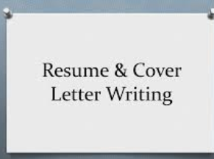
How to Write CV and Cover Letter
Abdirahman Sheikhdon
GTEC, Garowe
May 2022

Slide 2
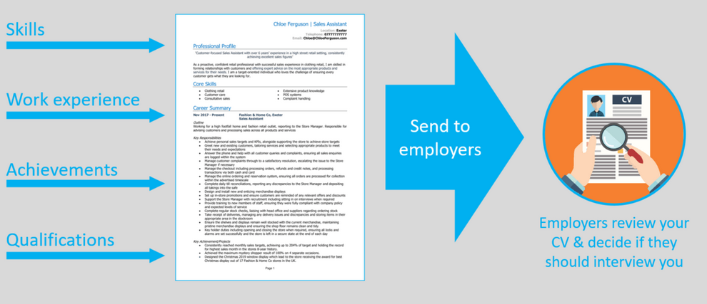
Literal meaning: "The course of life”
What is Curriculum Vitae(CV)?
is a detailed document highlighting your professional and academic history.
CVs typically include information like work experience, education, achievements and awards, research, skills, language, references , itc.

Slide 3
August 2021 to present: Teacher of Math at ABC secondary school at Bosaso, Puntland, Somalia.
Main duties includes:
Designed and implemented lesson plans that incorporated Algebra I and II
Created interactive learning environment by using Smart board and mathematical software.
Managed groups of up to 90 students and provided them with behavioral guidelines
Encouraged class discussion and maintained positive learning environment.
Conducted test and final exams with immediate feedback to the students
Key achievement:
Prepared and run after-school tutoring for students with learning difficulties that helped improve their final test results by 30%.
Sample
Abdi Noor Ali
ZHO 212, Gardo, Puntland, Somalia
+25290-0000000/Whats App
abc@gmail.com
Skype Id aa_bb
To obtain a teaching position in an Primary/secondary classroom where I can employ my skills in creating a fun and productive learning experience for students
Sept. 2019- 2021: Diploma in Secondary Education majoring Math and Physics at GTEC, Garowe, Puntland, Somalia
Augt 2015 – July 2019: Secondary Learning Certificate, at ABC Secondary at Badhan, Puntland State of Somalia
Personal information
Objectives/Career summary
Education
Experience
Skills
Membership
Research
Language
References
Challenges of Teaching First Year: Case of Teaching Fresh students at XYZ Secondary schools in Alula District, Gardafu Regions, Puntland State of Somalia.
Name
Title
Company/Organization
Phone Number
E-mail
Member for Puntland Teachers Associaiton, HQ, Garowe, Puntland, Somalia
Creative lesson planning
Software (Microsoft Mathematics, Math Editor)
Behavioral management
Patience and understanding
Communication skills
Critical thinking
Time management
Somali ------------- Native
English -------------- Fluency
Arabic----------------Fluency
French --------------- beginner

Slide 4
Cover letter?
A cover letter is your opportunity to introduce yourself and to demonstrate the match between an employer’s job requirements and your skills and qualifications.
It customizes your application for a particular position, organization and industry and should always accompany your C.V.

Slide 5
Steps
Know Yourself
Know Employer
Writing Your Cover Letter
Formatting
Proof reading
Sending

Slide 6
How to write cover letter
Company/Organization
Address
Subject
Salutation
Your mailing address
Why are you writing?
What you have to offer
How you will follow up
Your signature
Thank the employer for his/her time and consideration.
Indicate that you would like an interview in person or by phone.
Say that you look forward to hearing from him/her.
You may mention the best time and place for the contact person to reach you, and phone number/e-mail address.
Identify the specific position which you are applying.
State where you heard of the job opportunity and express your interest in the position.
Add some relevant information about the company and briefly outline how your qualifications might be a match.
This section should grab the reader’s attention so that he/she is compelled to continue reading the entire letter.
Keep this section relatively brief
Draw a clear connection between the job you are seeking and your qualification and experience
Explain why your qualifications and the job requirements are a good match.
Work in detailed examples and specifics about related aspects of your education and experience.

Slide 7
Sample of cover letter
I am writing to apply for the post of primary science teacher. I was immediate drawn to your advertisement on GTEC website. I am confident that my qualification and experience make me an ideal candidate for this position. I have recently completed diploma of primary teacher at GTEC.
A copy of my CV was attached.
ABC Primary School
Burtinle, Puntland, Somalia
Ref: Application for the Post of Science Teacher
Dear Sir/Madam
Your mailing address
Why are you writing?
What you have to offer
How you will follow up
Your signature
During the course of my study, I have pursued a number of science courses and educational courses include educational psychology, teaching methods, measurement, evaluation, and others. My experience include one year for teaching science at XYZ primary schools at Jalam and one-month teaching practice at Darwiish Primary schools at Garowe. This allowed me to use my skills and knowledge in a variety of methods in content delivery.
I would welcome the opportunity to apply my skills and experience with teaching science at primary school.
Please contact me through email: aab@gmail.com or mobile phone 00000000
Thanks for your time and consideration of my application.
I look forward to your response at your earliest convenience.
Best Regards
Abdi Noor Ali

Slide 8
Sample Email
Subject: Science teacher
Dear Sir/Madam
Please find attached my application for the science teacher position you advertised on the GTEC website. I have enclosed both my C.V. and cover letter.
For further information, please do not hesitate to contact me at
090 0000000
Thank you for considering my application.
Sincerely,
Abdi Noor Ali

