Slide 1

TRAINING OF TRAINERS
IBTVET/EBTVET INSTRUCTORS
Facilitator: Abdirahman Sheikhdon
18th to 22nd Jenaury 2021

Slide 2

Introduction and Objective
The main objectives of the training are to:
Understand learning, learning styles and how people learn
Familiarize and use innovative pedagogy skills
Develop effective training programs
Prepare and deliver training programs
Engage and motive trainees in effective ways
Recognize the different training evaluation methods and learner assessment

Slide 3
Training Topics
Innovative teaching methods
Lesson plan
Presentation
Brainstorming
Demonstration
Discussion
Problem solving
Role play
Discovery
Case Study
Field trip
Topic one
Topic two
Topic three
Topic four
About ToT
Training Cycle(Needs assessment, objectives, design, implementation and evaluation)
Inclusion, gender and child protection
Safety
Innovative pedagogy
Learning and learning styles
Adult principles
Competency of TVET
Cooperative learning
Experimental learning
Individual learning
Coaching Skills
Motivation of Students
Learning assessment
Training Evlaution
Pre/post test

Slide 4
No of Triangles?

Slide 5

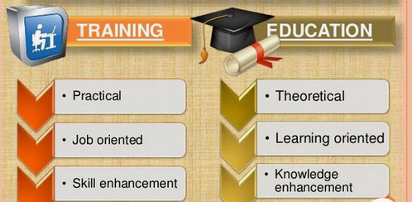
Training
Training is the process of learning the skills that you need for a particular job or activity.
Training vs Education

Slide 6

Training of Trainer(ToT)
ToT is intended to train new trainers who are less experience with a particular topic or skill.

Slide 7





Training Cycles
It is needed to conduct and
analysis data, to identify specific needs.
The main reason is ensure there is
a reason to conduct training. (Gap filling)
the training should be
evaluated to determine if it was successful and met training objectives.
Assess and analysis needs
Develop learning objectives
Design and develop the program
Implement the design
Evaluate performance
After determining training
need, the next step is to state training objectives
A trainer will complete various activities that were prepared before the
training.
Contents and Methodology

Slide 8


Slide 9
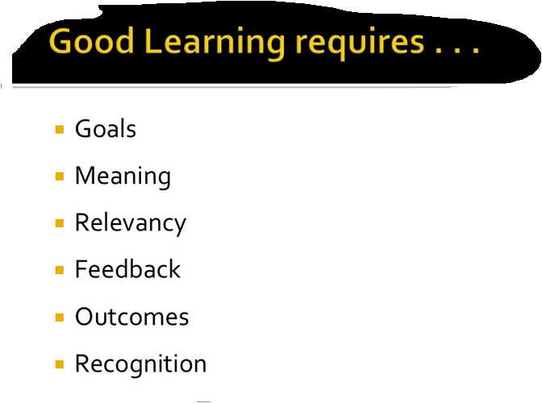

Slide 10
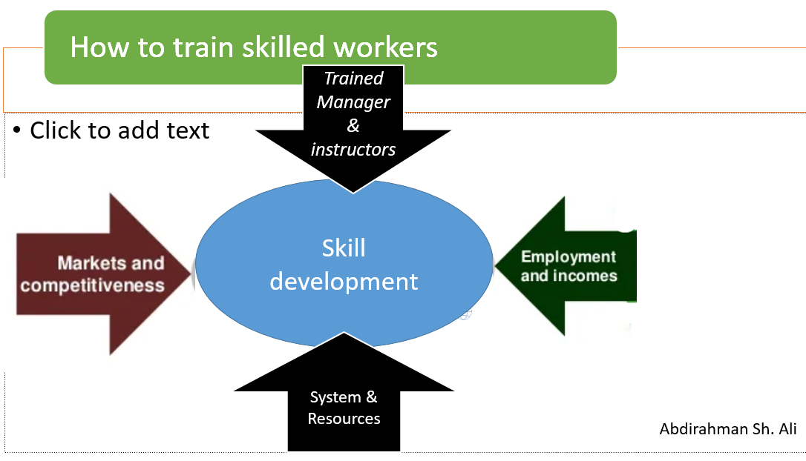


Slide 11












Slide 12





Work Safety
Workplace safety refers to the working environment at a TVET institute and encompasses all factors that affect the safety, health, and well-being of trainees and employees

Slide 13




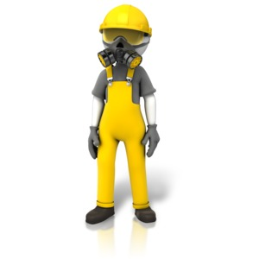



Safety

Slide 14


Thanks for your time

