Slide 1
Training Methods

Slide 2


Slide 4
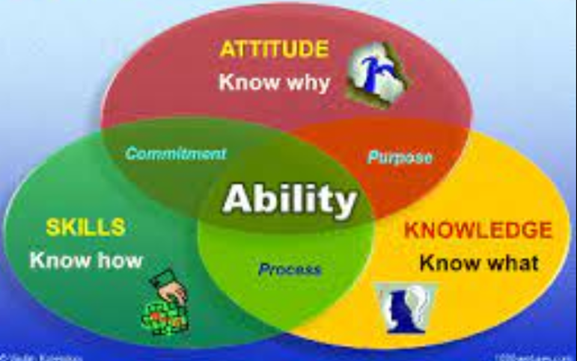
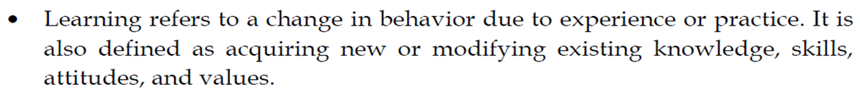

Slide 5
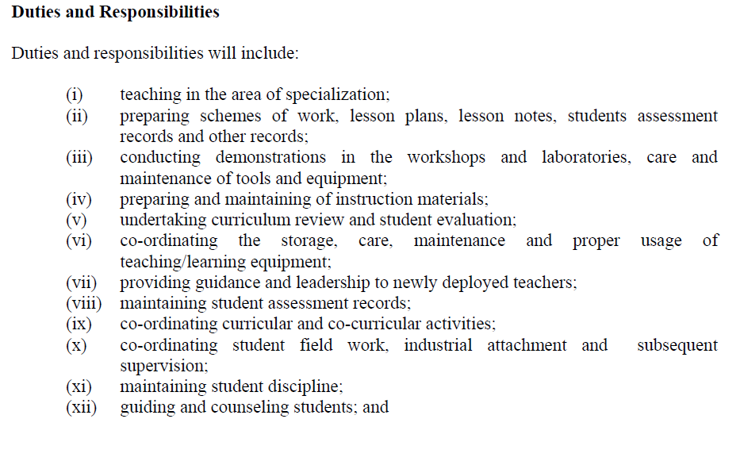

Slide 6
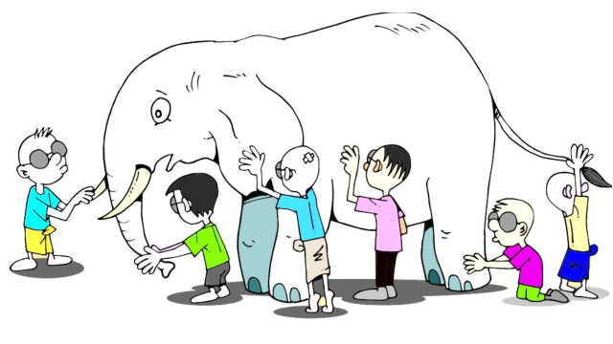

Slide 7

Learning Style
To test your learning style, scan the below bar code, fill out the questionnaire, and click Ok to see the result.

Slide 8



Slide 9
Innovative Teaching Method for TVET
Innovative teaching methods for TVET implies that the role of the trainers will change to a facilitator that indicates a shift from a teacher-centered to a learner-centered approach.

Slide 10

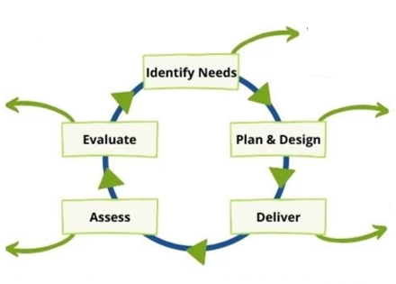




Teaching Cycle

Slide 11
Stages of Training Methods
Teaching preparation
Teaching delivery
Teaching Evaluation

Slide 12
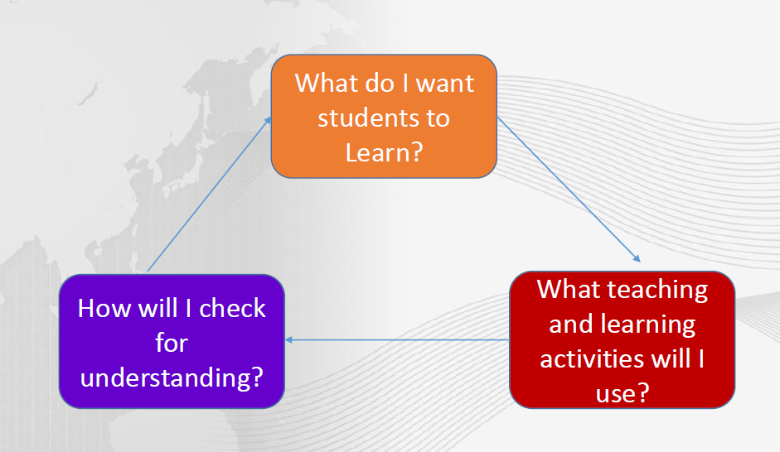

Slide 13

Sequence of Lesson Develiry

Slide 14
Lesson Plan
A lesson is an organized set of activities designed to present one manageable-sized piece of your course.
Who are they? (audience)
What do they already know? (skills and knowledge)
Why should they learn about this? (experience, training, education)
What must they learn? ( areas of interest)
What must they do to learn? ( attending training )
How will they demonstrate their learning? ( different methods)

Slide 15
The stages of a lesson plan are as under:
Motivation (beginning)
Guidance (middle)
Practice (end)

Slide 16

Basic Concept of Lesson Planning

Slide 17
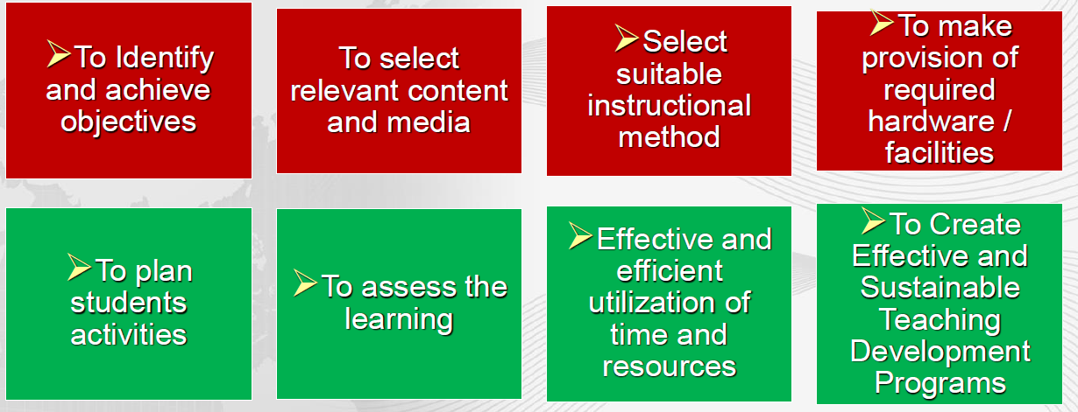
Need for Lesson Plan

Slide 18
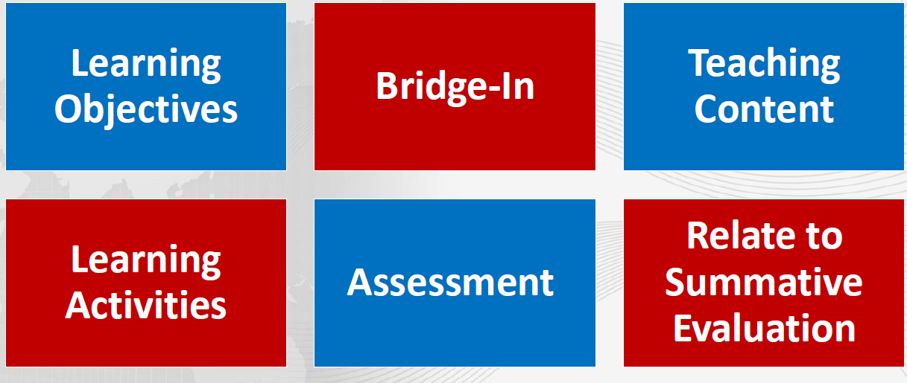
Parts of Lesson

Slide 19
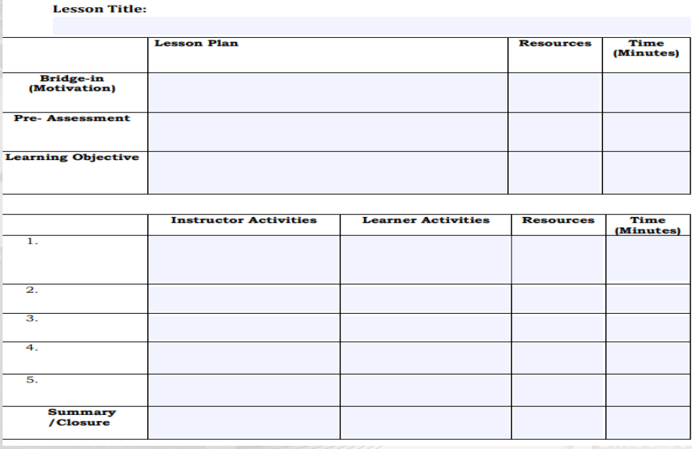

Slide 20
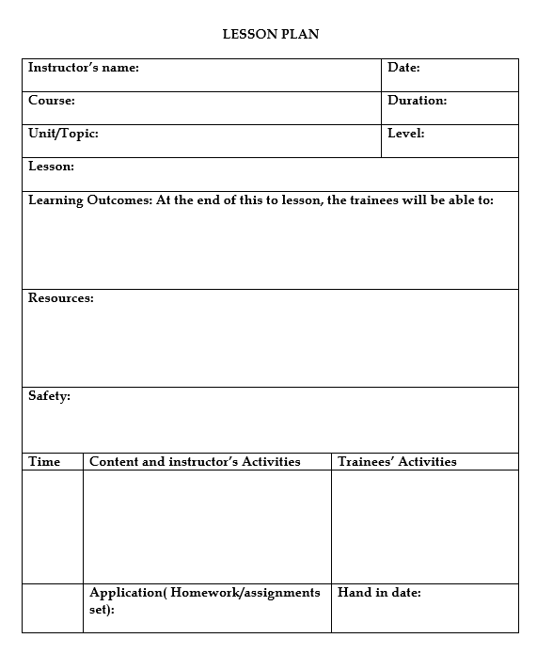

Slide 21
Presentation
Prepare and organize your presentation
Check any equipment
Keep the presentation short (15-20 minutes).
Use simple, clear language that participants will understand.
Use questions during the presentation to engage participants in the material you are presenting.
Use open body language and a friendly, clear tone of voice.
Move around the room as you present
To wrap up your presentation, summarize and repeat the main points

Slide 22
Brainstorming
Brainstorming is a method of generating ideas and sharing knowledge to solve a particular problem.
Explain that the purpose
Take one idea per participant, one at a time.
Accept all ideas and do not judge or criticize any ideas.
Encourage participants to let their ideas flow.
Encourage all participants to give ideas.
Do not rely on a few participants to give all the ideas.
One person should facilitate the brainstorming and another person should record the ideas.
After the brainstorming, the facilitator and participants can use the list of ideas to address a problem

Slide 23
Demonstration
Demonstration is a teaching method used to communicate an idea with the aid of visuals such as flip charts, posters, Powerpoint, etc.
Gather all materials and equipment that you will use during the demonstration.
Make sure that all participants will be able to see the demonstration.
Explain each step slowly and clearly as you demonstrate it.
Demonstrate 2 or 3 times if needed.
After the demonstration, ask a volunteer to repeat
Then divide participants into small groups or pairs and ask them to practice what you and the volunteer have just demonstrated.
Help or answer questions as needed.

