Slide 1
Innovative Pedagogy Skills

Slide 2

Introduction
NAME,
POSITION,
QUALIFICAITON, INSTITUTION

Slide 3

Expection

Slide 4
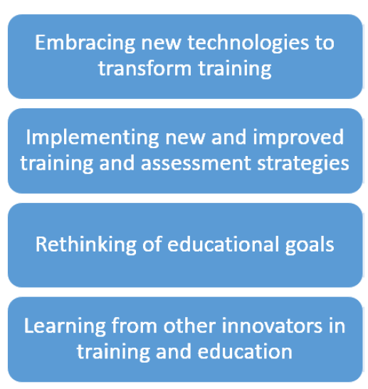

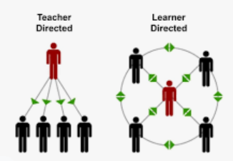
Innovative pedagogy skills
Basic conditions of learners
Innovative pedagogy is a teaching-learning approach that enables trainees to engage and understand areas of learning.

Slide 5
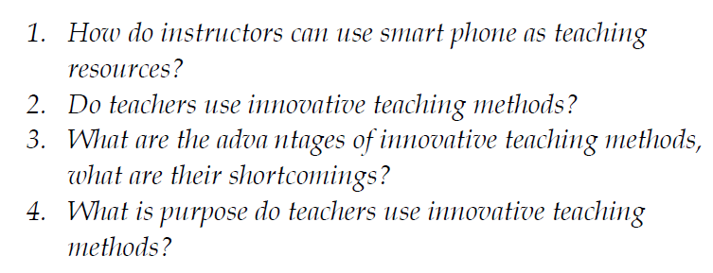
Technology and Teaching-learning
Technology rephrase the human brain
Digital technologies change our way of life, ways of communication, way of thinking, feelings, and channels of influence on other people, social skills, and social behavior.

Slide 6
Traditional way vs Innovative way
Traditional way | Innovative way

Slide 7






What is learning?
Learn is to:
Think
Read
Write
Do
Share
Compromise for further learning

Slide 8

Active and Passive Learning

Slide 9



Domain of Learning
Knowledge
Skills
Attitude
Cognitive
Psychomotor
Affective

Slide 11

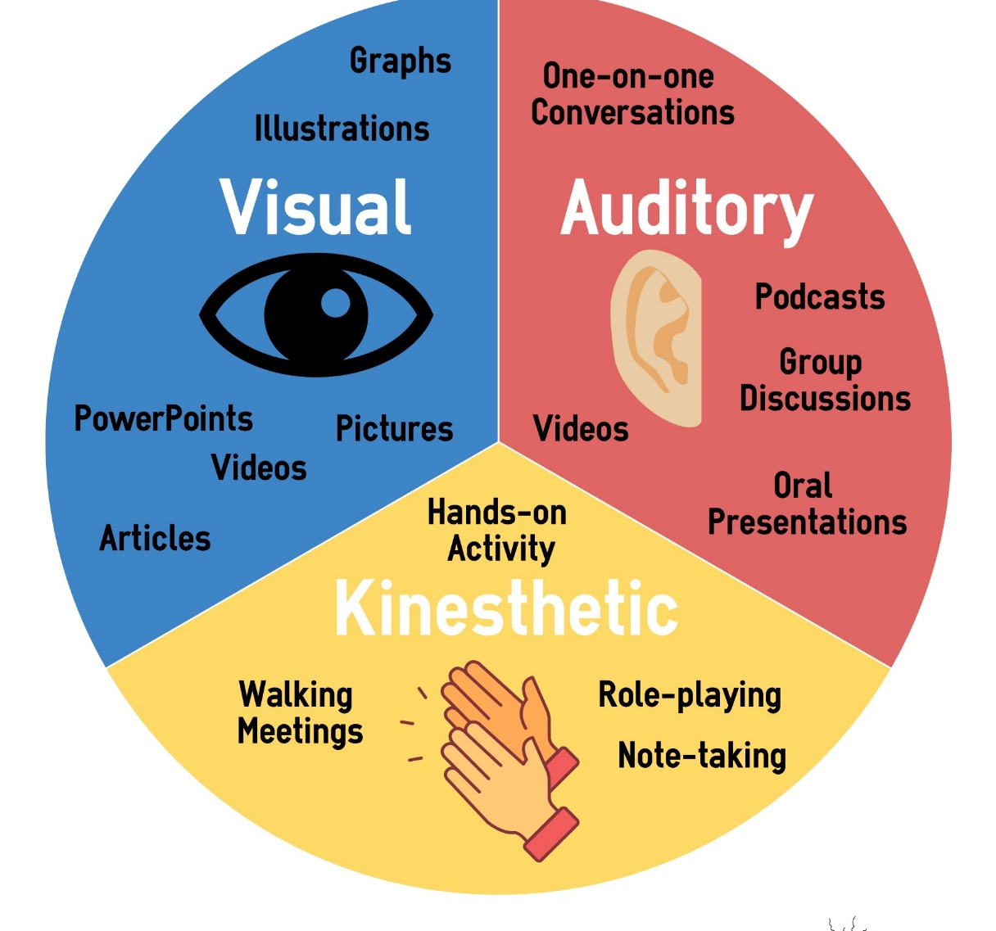


Understanding learning sytles

Slide 12
Adult learning
Respect
Affirmation
Experience
Relevance
Dialogue
Engagement
Immediacy

Slide 13



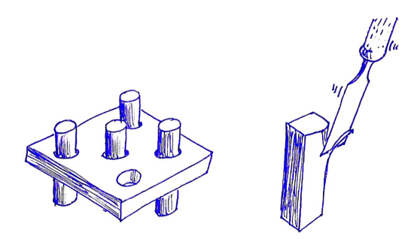
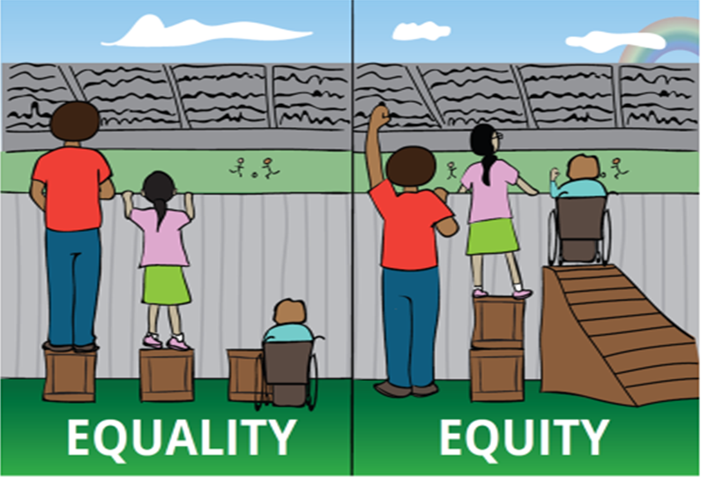
Inclusive Education
Inclusive approach to education, the learner is never the problem; it is always the system that is the problem.
Inclusive education is about overcoming discrimination and supporting education systems to realise every child’s right to an education.

Slide 14
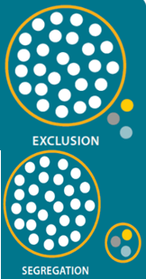


Slide 15
Competences Needed for TVET Instructors
Personal competencies
Pedagogical Competencies
Professional Competencies
Social competencies
Employers’ Engagement

