Slide 1
Coaching

Slide 2
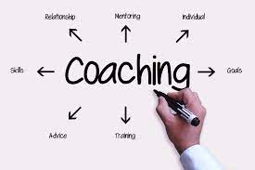
Coaching
Coaching is a process where a coach supports a coachee to make a change, learn something new or achieve goals.

Slide 4
How does Coaching work?
Committed listening
Paraphrasing
Presuming
Asking Powerful Questions
Feeding back:

Slide 6
Motivation of Learners
Motivation is the process that initiates, guides, and maintains goal-oriented behaviors.

Slide 7
Types of Motivation
Extrinsic motivations
Intrinsic motivations

Slide 8
Uses of Motivation
Uses of motivation include:
Help improve the efficiency of people as they work toward goals
Help people take action
Encourage people to engage in health-oriented behaviors
Help people avoid unhealthy behaviors such as risk-taking and addiction
Help people feel more in control of their lives
Improve overall well-being and happiness

Slide 9
Approaches to Motivate Trainees:
Sharing successful story
Encouraging
Get involve
Get Creative
Offer incentives
Use quotation “A journey of thousands miles start with one step”

Slide 10
Learning Assessment
Assessment is a systematic process of gathering, interpreting and acting upon data related to students learning and experience for developing a deep understanding of what trainees know, understand and can do with their knowledge because of their education experience.

Slide 11
Types of Assessment
Diagnostic
Formative
Summative

Slide 12
Classroom Assessment Techniques
Question and Answer:
Think-Pair-Share
Mind Mapping:
KWL-Chart
Others

